Slide 1
COVID -19
DATA ANALYSIS
CS244 PROJECT
Group no-5
Team members:
Chetna Rao - 2001ME17
Hemaswi - 2001CB30
Priyanka Kumari- 2001ME53
Soma Mani Kumar - 2001ME27
Srujana Siripurapu- 2001ME74
Vajinapally Sreeyusha - 2001ME79

Slide 2

Coronavirus
The coronavirus or Covid-19 is a large family of viruses that causes illnesses ranging from the common cold to acute respiratory syndromes, but the current virus is a novel strain not seen before. Common symptoms of the novel coronavirus strain include respiratory symptoms such as fever, cough, and shortness of breath, according to the WHO. The WHO has declared the coronavirus epidemic as a global health emergency.
This project shows the effect of coronavirus worldwide.
In this project the Dataset used for globally is COVID-19. Here there are many visualization and comparison of effects of different countries.

Slide 3
Libraries used in project
Data interpretation
Data visualisation
Numpy (np)
pandas(pd)
Matplotlib (plt)
Plotly (px)
Seaborn (sns)

Slide 4
Data preprocessing and cleaning

Slide 5
Objective:
To understand techniques such as lambdas and manipulating csv files .
To describe common Python functionality and features used for data science.
To query Data Frames structures for cleaning and processing.
Notes:
To clean and process Data Frames structures by querying them.

Slide 6
LIBRARIES USED:
Pandas(pd):It Provides built-in data structures which simplify the manipulation and analysis of data sets.
Numpy(np):Introduces objects for multidimensional arrays and matrices, as well as functions that allow to easily perform advanced mathematical and statistical operations on those objects
Notes:
It has built-in data structures that make manipulating and analysing data collections easier.
Introduces multidimensional arrays and matrices, as well as functions that make complex mathematical and statistical operations on these objects simple.

Slide 7
Data Frame:DataFrame is a 2-dimensional labeled data structure with columns of potentially different types.
Data Frames methods:
df.method()
head( [n]), tail( [n]):
describe():
max(), min():
mean(), median():
std():
sample([n]):
dropna():
Description
first/last n rows
generate descriptive statistics (for numeric columns only)
return max/min values for all numeric columns
return mean/median values for all numeric columns
standard deviation
returns a random sample of the data frame
drop all the records with missing values
Notes:
A DataFrame is a two-dimensional labelled data structure with multiple sorts of columns.

Slide 8
Methods used for cleaning data
Splitting- Pandas sample() is used to generate a sample random row or column from the function called data frame.
Imputation-Imputation is the process of replacing missing data with substituted values.
Interpolation-Interpolation is a type of estimation, a method of constructing new data points within the range of a discrete set of known data points
Notes:
Pandas sample() is used to produce a random sample row or column from the data frame function.
Interpolation is a method of building new data points within the range of a discrete collection of known data points, and it is a sort of estimation.

Slide 9
PREPARATION OF DATA FOR CONSUMPTION :
Cleaning data
Removing or modifying data that is incorrect,incomplete, irrelevant, duplicated, or improperly formatted.
Grouping
Preparation of data
Grouping the related data
Creating
1
2
3

Slide 10
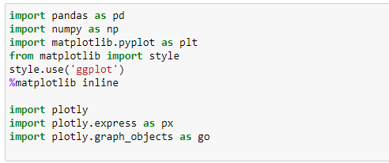
Loading python libraries
Notes:
These are the libraries we have used for the data cleaning and analysis of this project.

Slide 11
Reading data using pandas
Notes:
These are some of the files of the data we used in covid data analysis.
These files are read by using pandas library as shown in this slide.

Slide 12
Cleaning data
of covid cases in India

Slide 13
S. No. | Name of State / UT | Total Confirmed cases (Indian National) | Total Confirmed cases ( Foreign National ) | Cured | Death
1 | Andhra Pradesh | 12 | 0 | 1 | 0
2 | Chhattisgarh | 6 | 0 | 0 | 0
3 | Delhi | 38 | 1 | 6 | 1
4 | Gujarat | 43 | 0 | 0 | 3
5 | Haryana | 16 | 14 | 11 | 0
6 | Himachal Pradesh | 4 | 0 | 0 | 1
7 | Karnataka | 20 | 0 | 3 | 2
8 | Kerala | 131 | 7 | 11 | 0
9 | Madhya Pradesh | 23 | 0 | 0 | 1
10 | Maharashtra | 144 | 3 | 15 | 4
11 | Odisha | 3 | 0 | 0 | 0
Notes:
This is raw data of the given file, covid cases in india.

Slide 14
12 | Puducherry | 1 | 0 | 0 | 0
13 | Punjab | 29 | 0 | 0 | 1
14 | Rajasthan | 41 | 2 | 3 | 0
15 | Tamil Nadu | 32 | 3 | 1 | 1
16 | Telangana | 34 | 11 | 1 | 0
17 | Chandigarh | 7 | 0 | 0 | 0
18 | Jammu and Kashmir | 18 | 0 | 1 | 1
19 | Ladakh | 13 | 0 | 0 | 0
20 | Uttar Pradesh | 42 | 1 | 11 | 0
21 | Uttarakhand | 4 | 0 | 0 | 0
22 | West Bengal | 11 | 0 | 0 | 1
23 | Bihar | 7 | 0 | 0 | 1
24 | Mizoram | 1 | 0 | 0 | 0
25 | Goa | 6 | 0 | 0 | 0
26 | Manipur | 1 | 0 | 0 | 0

Slide 15
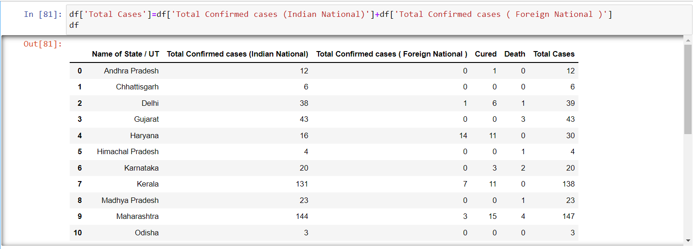
To reset the index of the dataset we use :
df.drop( [ ‘S. No . ‘] , axis=1 , inplace = True )
To find the total no of cases :
Total cases = Total confirmed cases( Indian National )+ Total confirmed cases( foregin National )
Notes:
As a cleaning process we have to remove the unwanted columns.
Here we have remove the column serial number by using drop func.
After that to find the total no.of cases we are adding the confirmed cases of indians and indians who are living in the foreign nation.
So that we are obtaining this data.

Slide 16
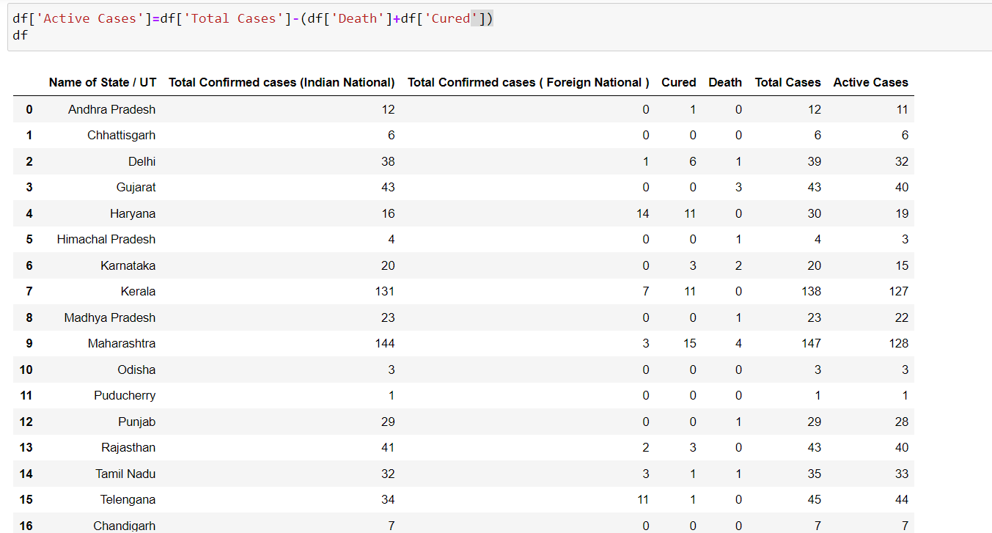
Finding no of Active cases :
Active cases = Total cases - (Death + Cured )
Notes:
Now to find the active cases , we are subtracting the death and cured cases from the total cases.
Clearly these are the columns we added to the given file as shown.
In this way we have to make the raw data into useful data for the performance .

Slide 17
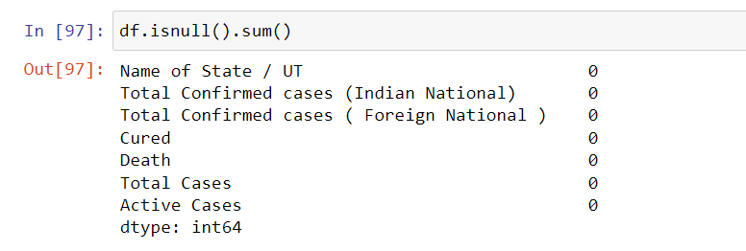
Removing the null values in the data of covid cases in India
Checking the no of null values :
Function used to check null values is :
df.isnull().sum()
Notes:
After that we have to check whether missing or null values are present or not.
As shown in the slide we can find out the total sum of null values present in each column.
Here in this data file there are 0 null values. Incase if we are having null values we have to replace them by using data frame methods.

Slide 18
Data Visualisation
For covid cases in India

Slide 19
Objective
To Learn the steps, needed to be taken to prepare the data for an analysis.
To Learn how to look at the data to find a good measure to establish.
The analysis based upon to Learn to visualize the result of the analysis.

Slide 20
Libraries Used
Matplotlib-python 2D plotting library which produces publication quality figures in a variety of hard copy formats.
Seaborn-based on matplotlib,provides high level interface for drawing attractive statistical graphics.Similar (in style) to the popular ggplot2 library in R.

Slide 21
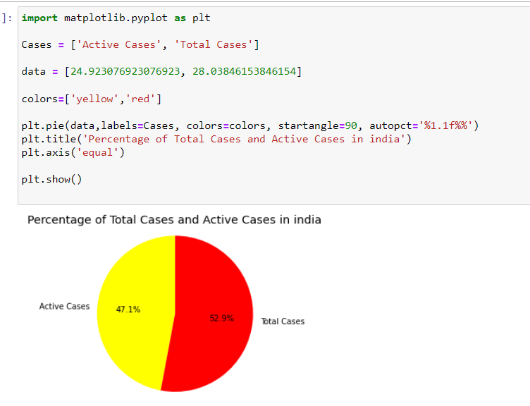
Pie chart of percentage of total number of cases and active cases in India :

Slide 22
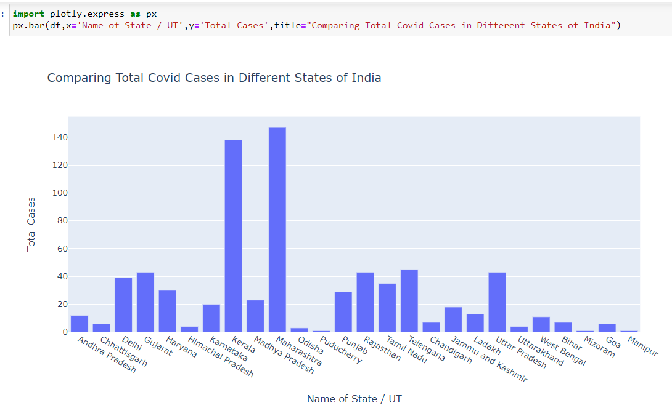
Graphical Representation :
Bar Plot

Slide 23
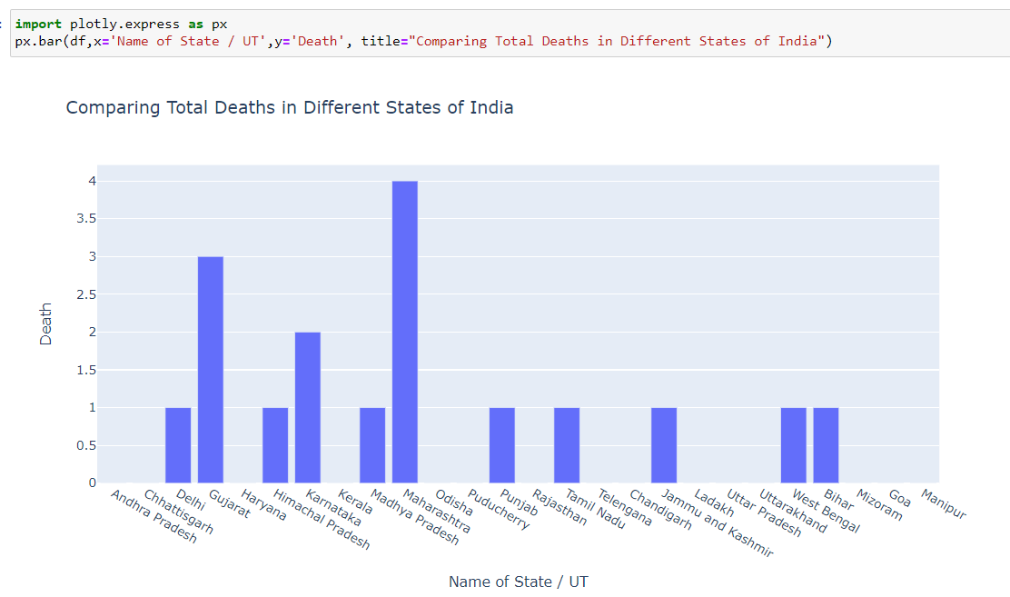

Slide 24
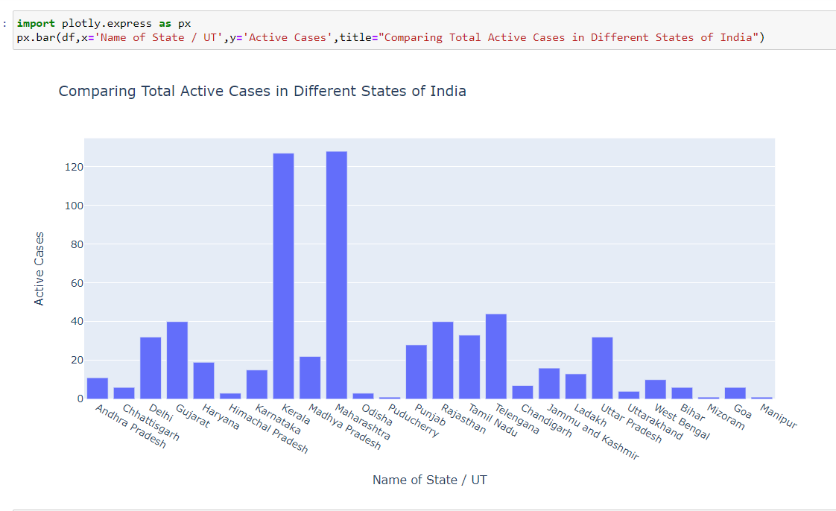

Slide 25
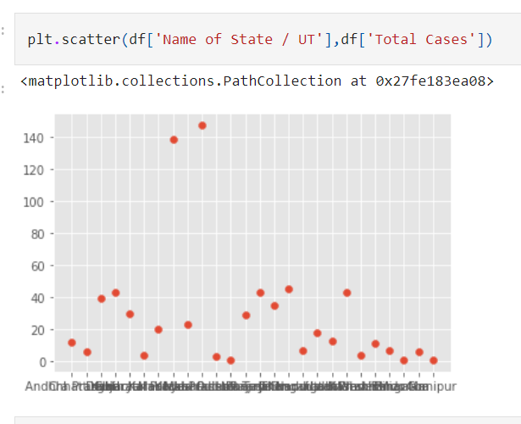
Scatter plot :

Slide 26
How coronavirus is rising Globally
We observed the total number of cases and new cases for a particular period of time ( 100 days ) and draw the conclusions from that.
Data on per day cases:
dbd_India=pd.read_excel(r"C:\Users\priku\OneDrive\Desktop\final covid project\per_day_cases.xlsx",parse_dates=True,sheet_name="India")

Slide 27
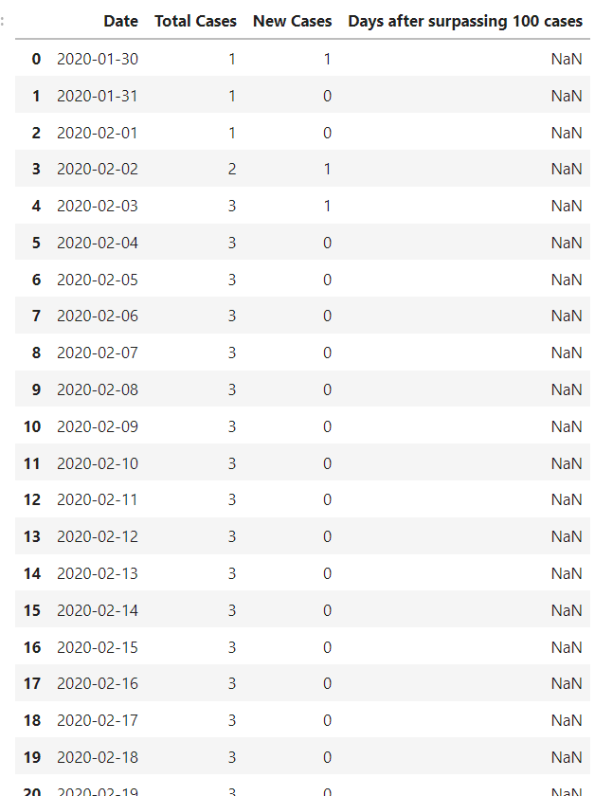
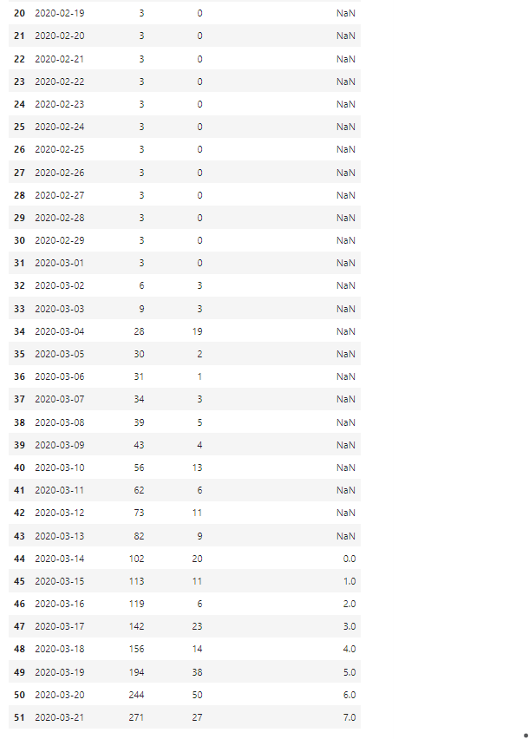

Slide 28
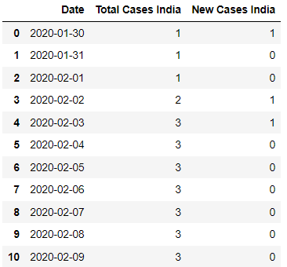
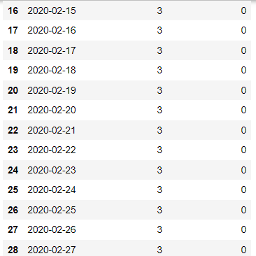
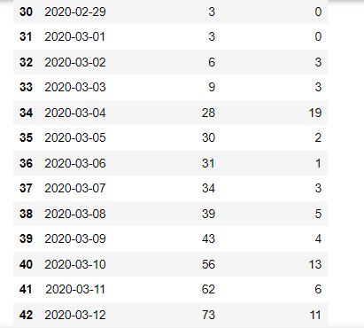
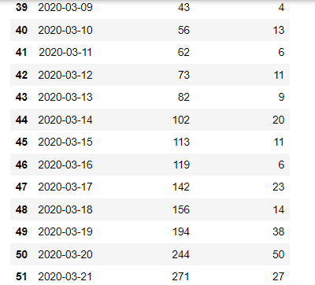
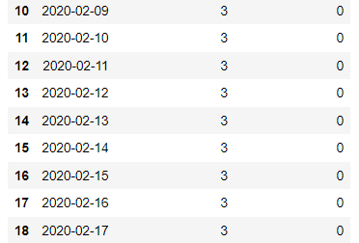
Cleaning and processing the data on per day cases :
Dropping the null values
We won’t need the 'Days after surpassing 100 cases' column for our analysis so we are dropping that column
dbd_India.drop(['Days after surpassing 100 cases'],axis=1,inplace=True)
Renaming Total cases as Total cases India and New cases as New cases India
dbd_India.rename(columns={'Total Cases':'Total Cases India','New Cases':'New Cases India'},inplace=True)

Slide 29
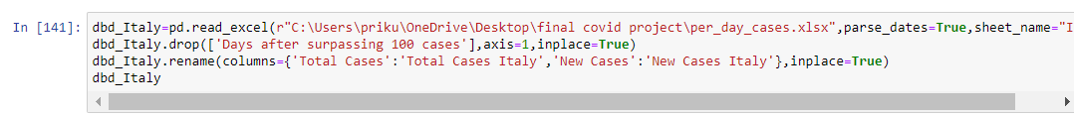
Cleaning and processing the data on covid cases in Italy :

Slide 30
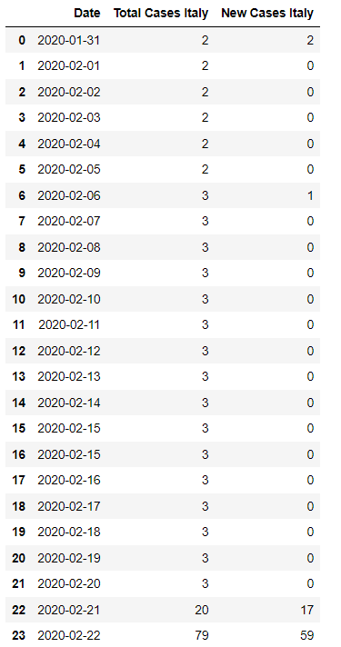
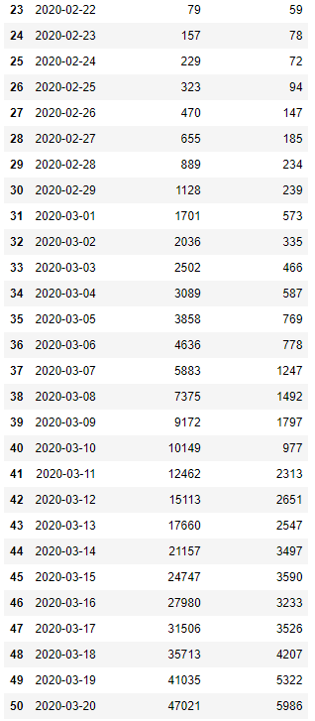

Slide 31
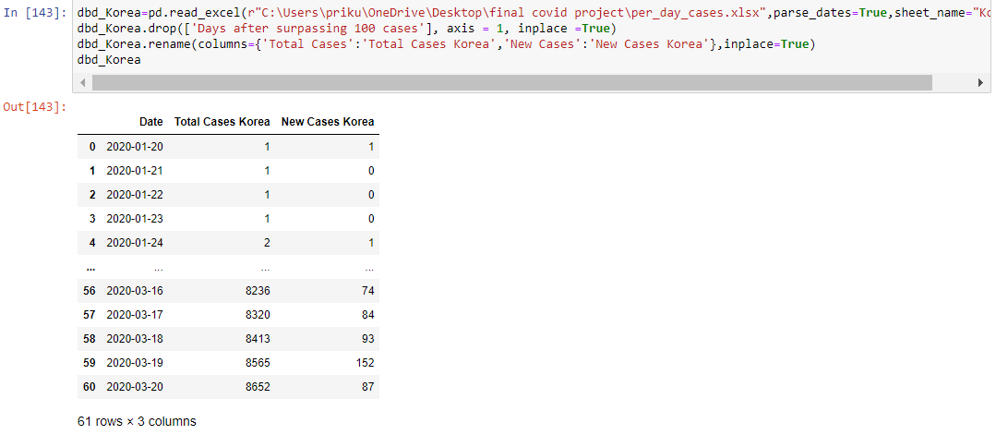
Cleaning and processing the data on covid cases in korea :
dbd_Korea=pd.read_excel(r"C:\Users\priku\OneDrive\Desktop\final covid project\per_day_cases.xlsx",parse_dates=True,sheet_name="Korea")
dbd_Korea.drop(['Days after surpassing 100 cases'], axis = 1, inplace =True)
dbd_Korea.rename(columns={'Total Cases':'Total Cases Korea','New Cases':'New Cases Korea'},inplace=True)
dbd_Korea

Slide 32
Cleaning and processing the data on covid cases in wuhan :
dbd_Wuhan=pd.read_excel(r"C:\Users\priku\OneDrive\Desktop\final covid project\per_day_cases.xlsx",parse_dates=True,sheet_name="Wuhan")
dbd_Wuhan.rename(columns={'Total Cases':'Total Cases Wuhan','New Cases':'New Cases Wuhan'},inplace=True)
dbd_Wuhan (OR)

Slide 33
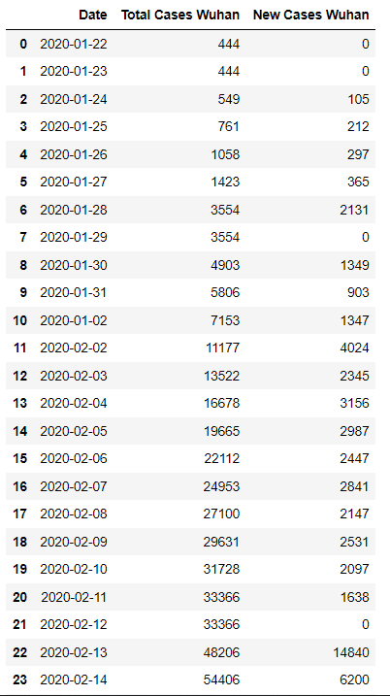
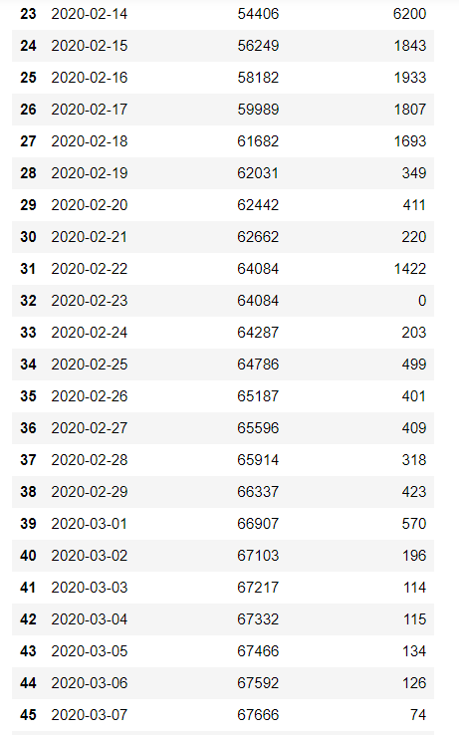
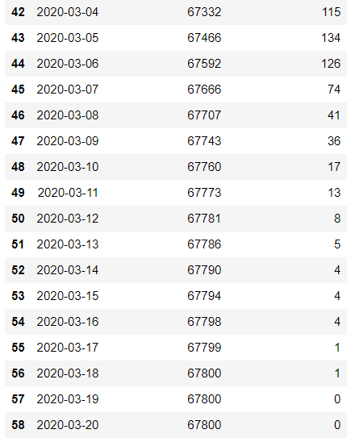

Slide 34
DATA VISUALISATION
(Based on day wise data)

Slide 35
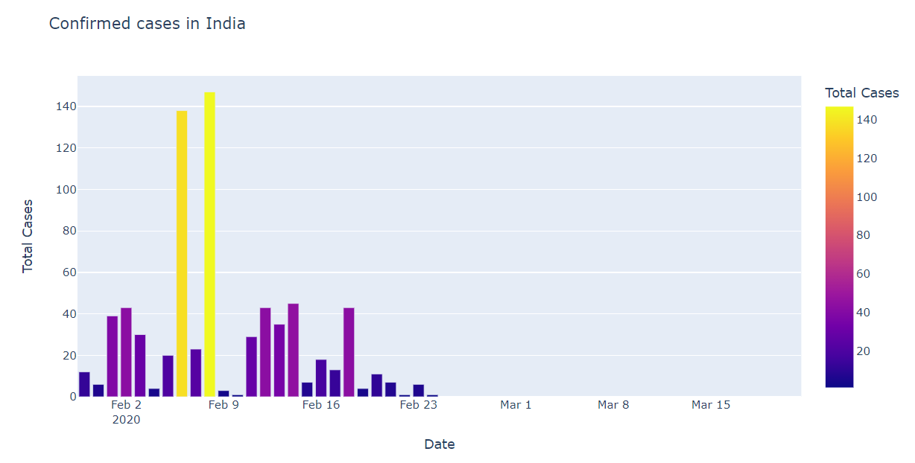
Confirmed cases in India
Notes:
Data visualisation for the data file - covid cases in india
It is a graph which shows the change in total no.of cases of indians day by day for a certain period of time using plotly method.

Slide 36
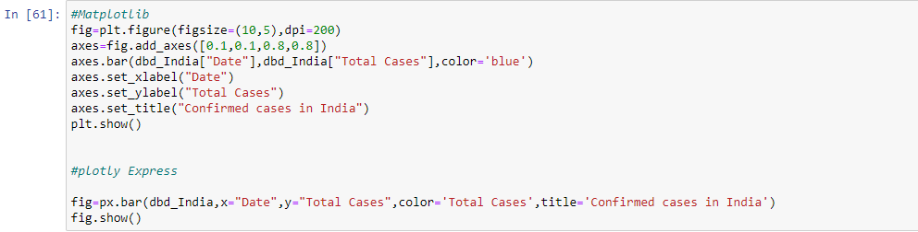
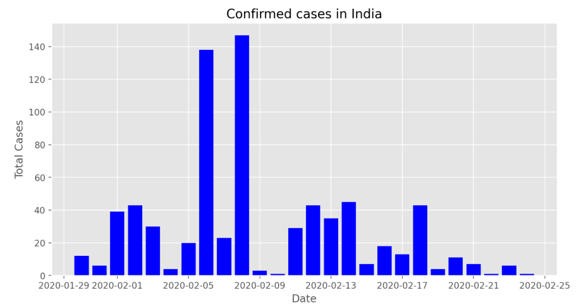
Plot of Total cases Daywise
fig=plt.figure(figsize=(10,5),dpi=200)
axes=fig.add_axes([0.1,0.1,0.8,0.8])
axes.bar(dbd_India["Date"],dbd_India["Total Cases"],color='blue')
axes.set_xlabel("Date")
axes.set_ylabel("Total Cases")
axes.set_title("Confirmed cases in India")
plt.show()
Notes:
It is an another method to plot the bargraph of the same information

Slide 37
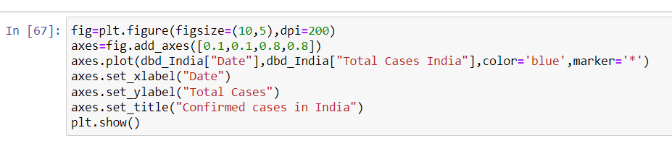
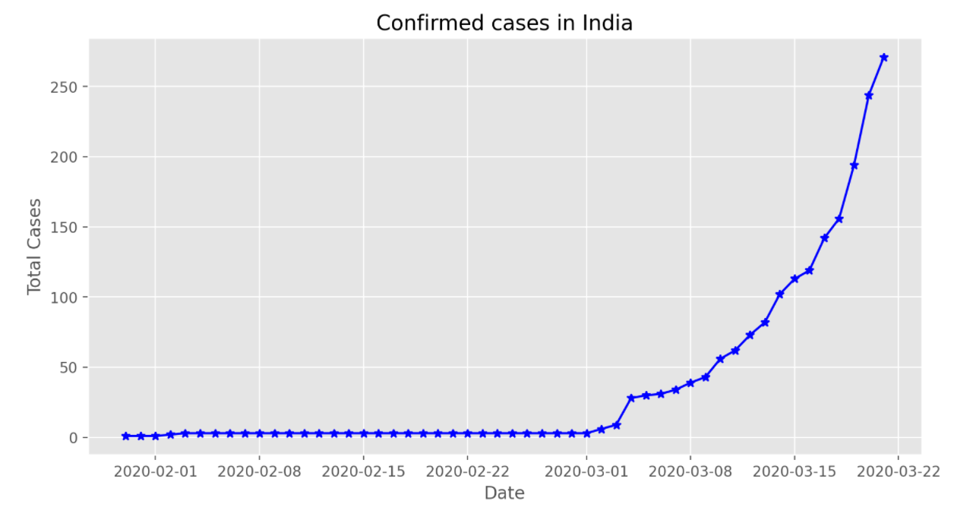
Notes:
Data visualisation for the data file - per day cases in india
This graph shows the day wise total no. of confirmed covid cases in india .

Slide 38
DATA VISUALISATION
(Other Countries)

Slide 39
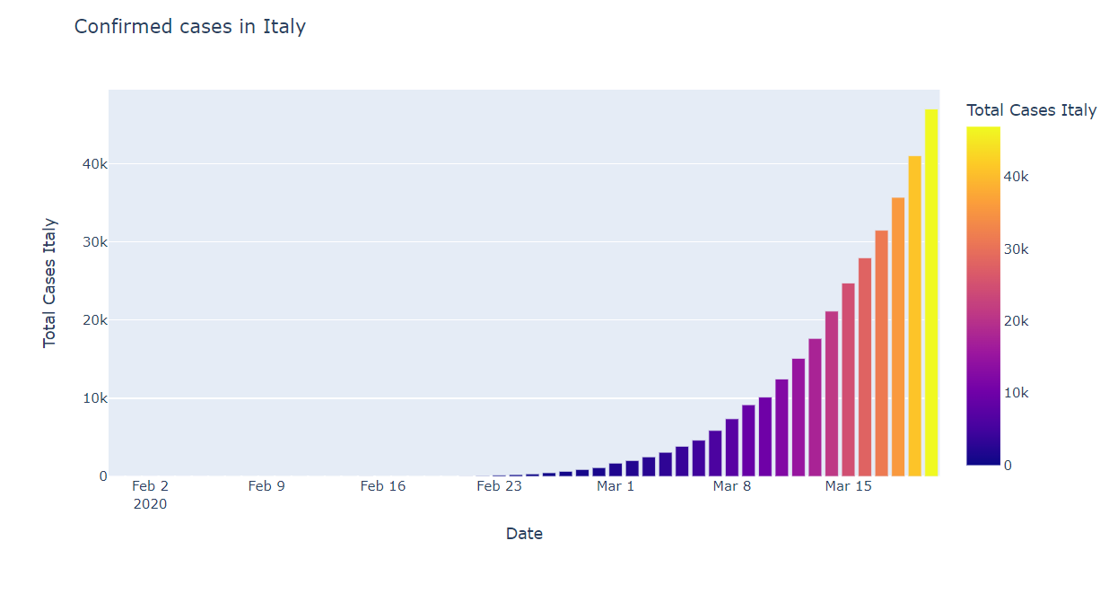
Italy
Plot of total cases
Notes:
It is the graph which shows the day wise total no. of confirmed covid cases in italy.

Slide 40
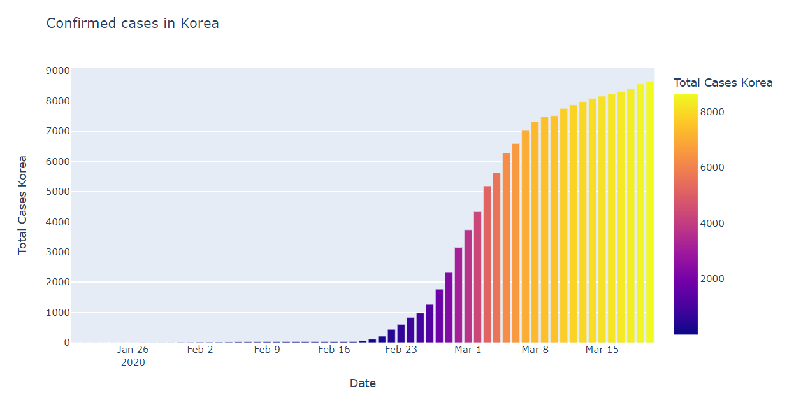
Korea
Plot of total cases
Notes:
It is the graph which shows the day wise total no. of confirmed covid cases in korea.

Slide 41
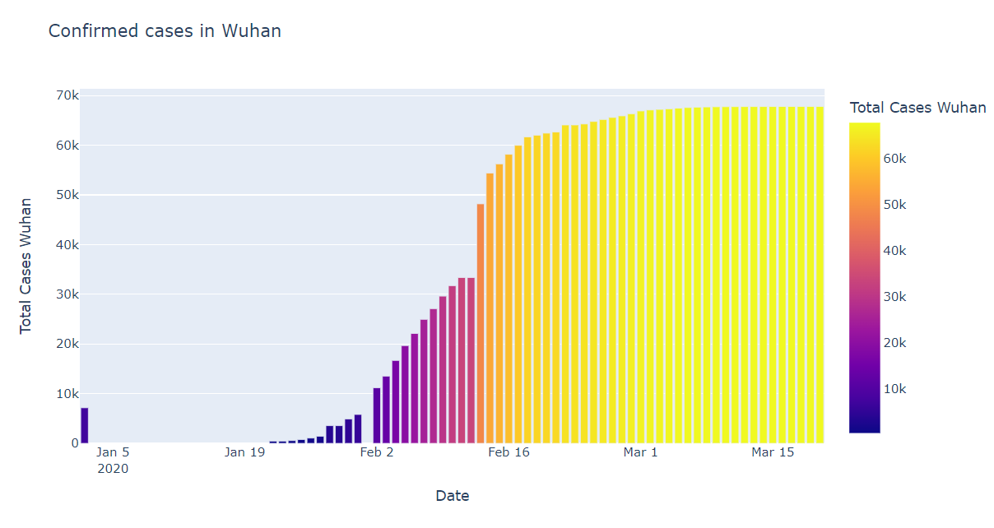
Wuhan
Plot of total cases
Notes:
It is the graph which shows the day wise total no. of confirmed covid cases in wuhan.

Slide 42
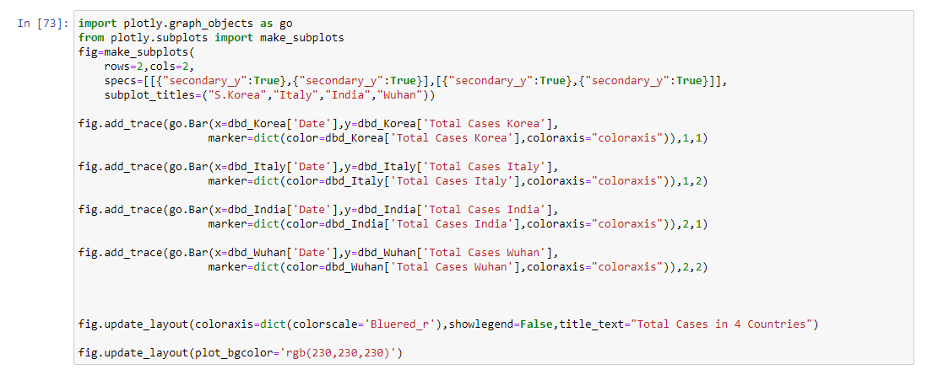
Total cases in four countries :
I
Notes:
This is the python code to plot the graphs of day wise change in confirmed cases in the four countries.

Slide 43
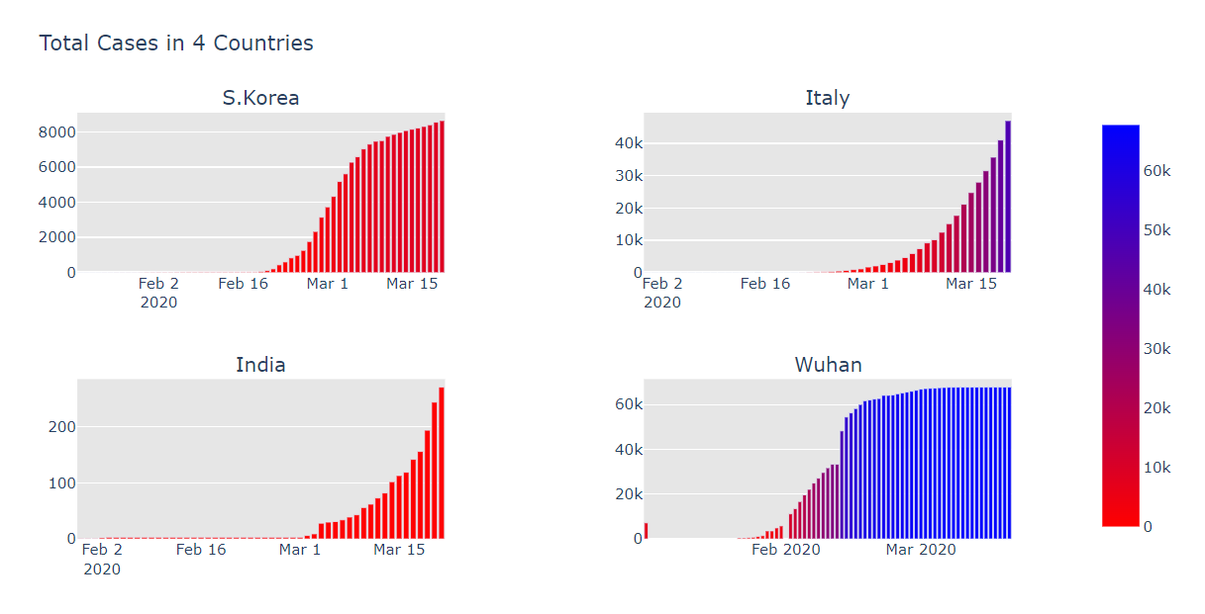
Notes:
These are plots which differentiate the daywise confirmed cases in each of 4 countries.

Slide 44
World wide analysis

Slide 45
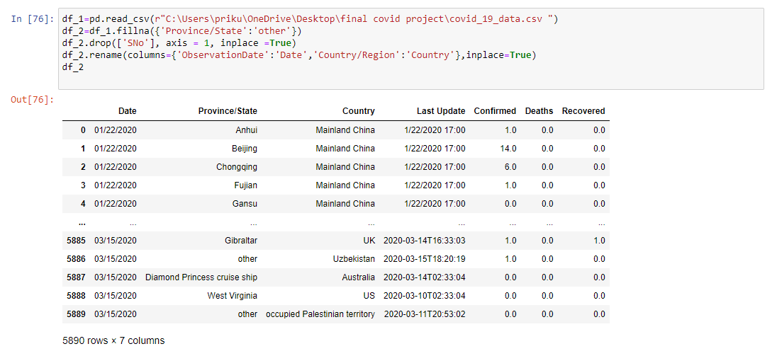
Data on worldwide coronavirus cases :

Slide 46
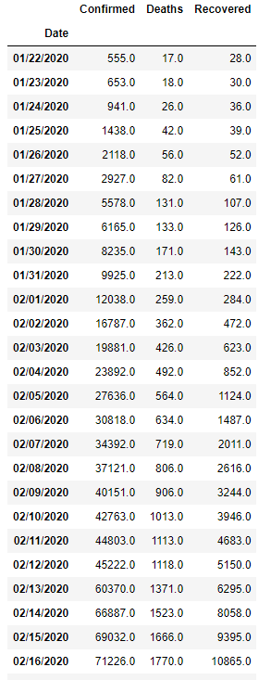
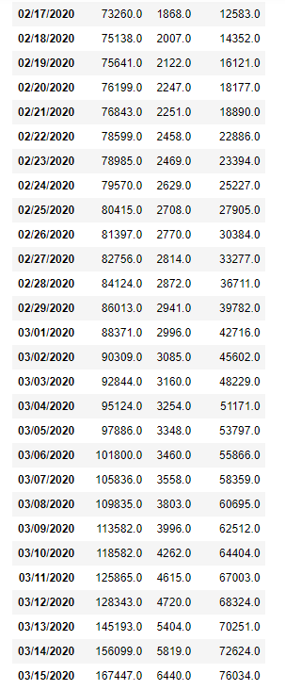
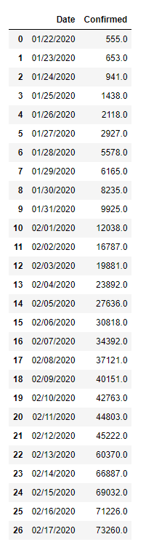
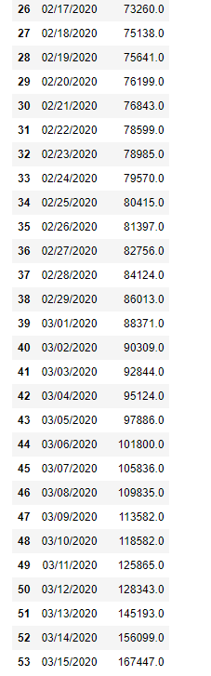
df_2.groupby('Date').sum() confirmed=df_2.groupby('Date').sum()['Confirmed'].reset_index()
confirmed

Slide 47
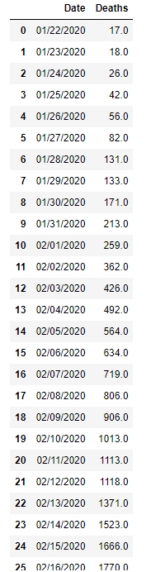
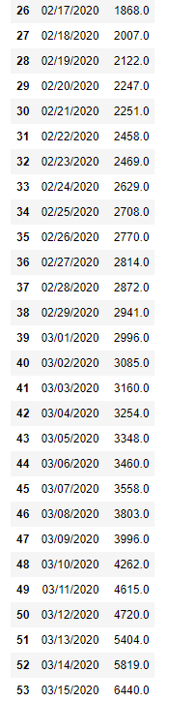
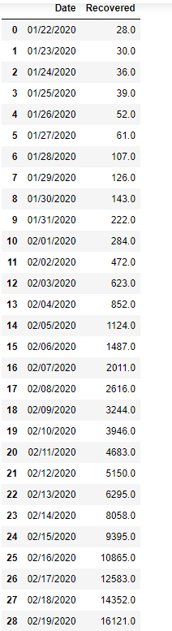
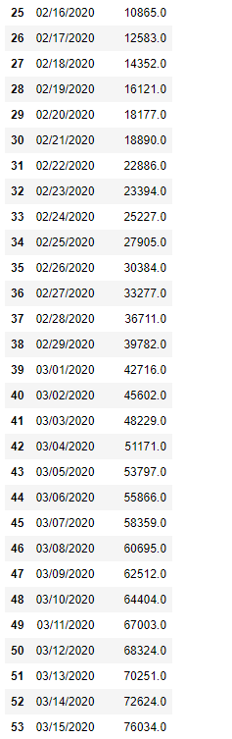
death=df_2.groupby('Date').sum()['Deaths'].reset_index() rec=df_2.groupby('Date').sum()['Recovered'].reset_index()
death rec

Slide 48
DATA VISUALISATION
(Worldwide)

Slide 49
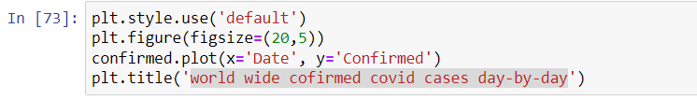
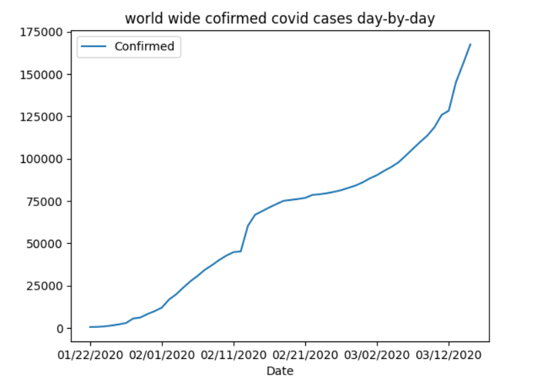
Plot of world wide confirmed covid cases day-by-day

Slide 50
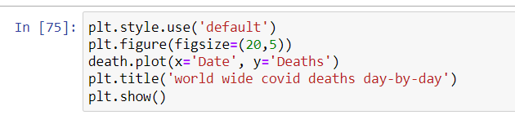
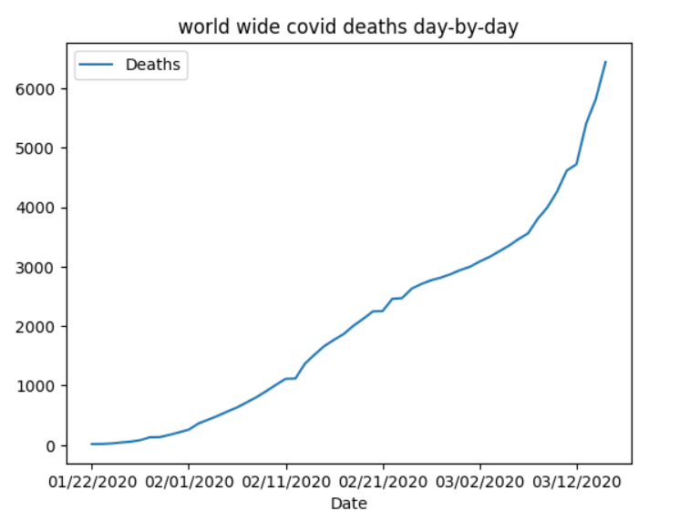
Plot of world wide covid deaths day-by-day

Slide 51
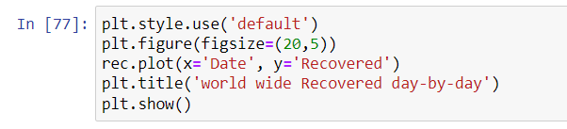
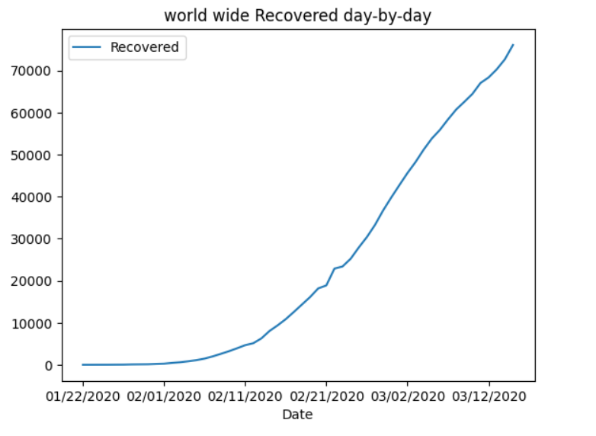
Plot of world wide Recovered day-by-day

Slide 52
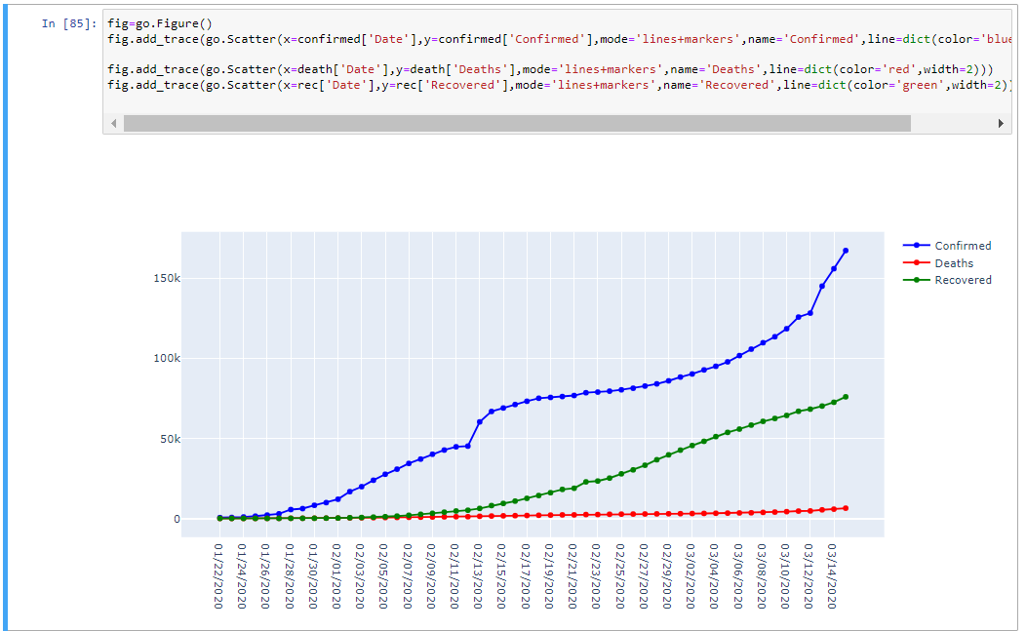
Comparing above 3 plots

Slide 53
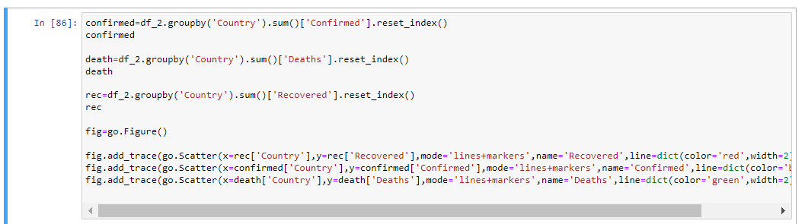
Plot of death,recovered and confirmed cases country wise

Slide 54


Slide 55
DATA VISUALISATION
(For oxygen shortage death & non virus death data in India)

Slide 56

Data on oxygen shortage deaths in India :

Slide 57

Data on non-virus deaths in India :

Slide 58

Plot of oxygen storage death cases in India statewise

Slide 59

Comparing deaths due to oxygen_shortage_death and non_virus_deaths

Slide 60


Slide 61
DATA STATISTICS

Slide 62

Sorting the states in ascending order based on the number of deaths :

Slide 63

Sorting the states in ascending order based on the number of active cases :

Slide 64

Sorting the states in ascending order based on the number of total cases :

Slide 65
DATA HYPOTHESIS

Slide 66
Objective
To find the nature of derived plot.
To find whether the plot was normally distributed or not.
To find whether the plot was right skewed or left skewed.

Slide 67
Libraries Used
Scipy: Scipy is a scientific computation library that uses NumPy underneath. SciPy stands for Scientific Python. It provides more utility functions for optimization, stats and signal processing. Like NumPy, Scipy is open source so we can use it freely.

Slide 68

Checking weather the plot plotted between total cases vs date of India is normally distributed or not.
Here the P value is less than 0.05 i.e the null hypothesis is rejected. Therefore the plot is not normally distributed.
INDIA

Slide 69

Checking weather the plot plotted between total cases vs date of india is right skewed or left skewed.
Here since the mean of the data is more than the median it is right skewed. That means null hypothesis is accepted.

Slide 70

Checking weather the plot plotted between total cases vs date of Italy is normally distributed or not.
Here the P value is less than 0.05 i.e the null hypothesis is rejected. Therefore the plot is not normally distributed
ITALY

Slide 71

Checking weather the plot plotted between total cases vs date of india is right skewed or left skewed.
Here since the mean of the data is more than the median it is right skewed.That means null hypothesis is accepted.

Slide 72

Checking weather the plot plotted between total cases vs date of Korea is normally distributed or not.
Here the P value is less than 0.05 i.e the null hypothesis is rejected. Therefore the plot is not normally distributed
KOREA

Slide 73

Checking weather the plot plotted between total cases vs date of Korea is right skewed or left skewed.
Here since the mean of the data is more than the median it is right skewed.That means null hypothesis is accepted.

Slide 74

Checking weather the plot plotted between total cases vs date of Wuhan is normally distributed or not.
Here the P value is less than 0.05 i.e the null hypothesis is rejected. Therefore the plot is not normally distributed
WUHAN

Slide 75

Checking weather the plot plotted between total cases vs date of Wuhan is right skewed or left skewed.
Here since the mean of the data is less than the median it is left skewed.
That means null hypothesis is rejected.

Slide 76
Thank you

